Slide 1
Introduction to Probability Theory and Information Theory
A Deep Dive into Probability Spaces, Shannon Entropy, and Mutual Information

Slide 2
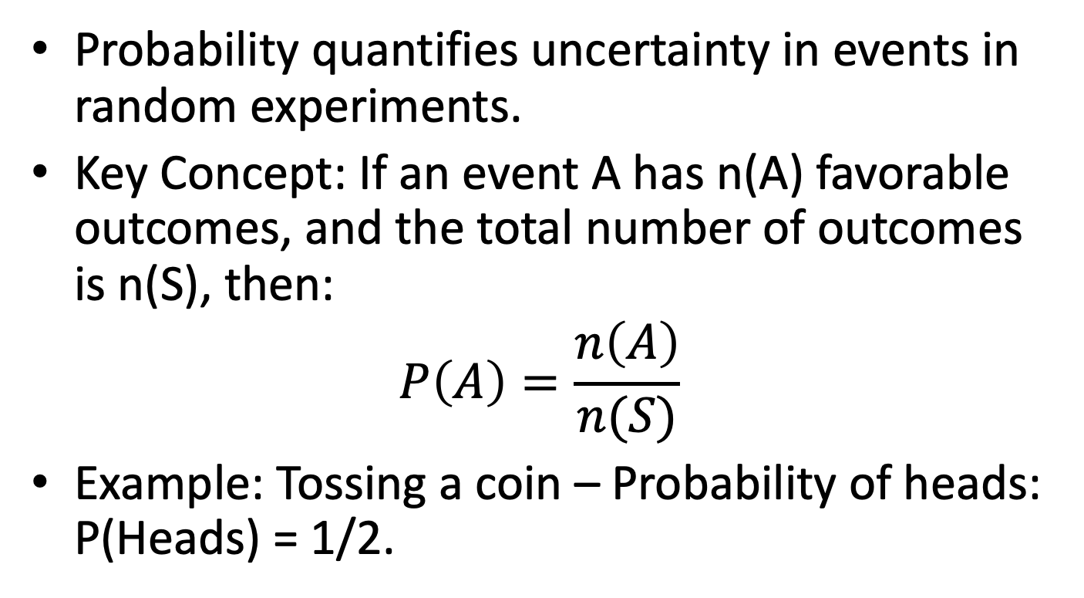
What is Probability?
Probability quantifies uncertainty in events in random experiments.
Key Concept: If an event A has n(A) favorable outcomes, and the total number of outcomes is n(S), then:
$$P\left(A\right)=\frac{n\left(A\right)}{n(S)}$$
Example: Tossing a coin – Probability of heads: P(Heads) = 1/2.

Slide 3
Probability Spaces
A probability space is the mathematical model for random experiments.
Components:
- Sample Space (Ω): The set of all possible outcomes.
- Events: Subsets of the sample space.
- Probability Measure (P): A function assigning probabilities to events, satisfying:
1. P(Ω) = 1
2. P(A) ≥ 0 for any event A
3. P(A ∪ B) = P(A) + P(B) for mutually exclusive events A and B.
Example: Rolling a die, sample space: Ω = {1, 2, 3, 4, 5, 6}.

Slide 4
Conditional Probability and Independence
Conditional Probability: P(A|B) = P(A ∩ B) / P(B)
Independence: Events A and B are independent if P(A ∩ B) = P(A) * P(B).
Example: Rolling two dice – result of one die does not affect the other.

Slide 5
Important Probability Rules
Addition Rule: P(A ∪ B) = P(A) + P(B) (for mutually exclusive events).
Multiplication Rule: P(A ∩ B) = P(A) * P(B) (for independent events).
Complement Rule: P(Not A) = 1 – P(A).

Slide 6
What is Information Theory?
Information theory quantifies how much information is contained in data.
Key Concept: Information reduces uncertainty.
Applications: Data compression, error detection, cryptography, communication systems.

Slide 7
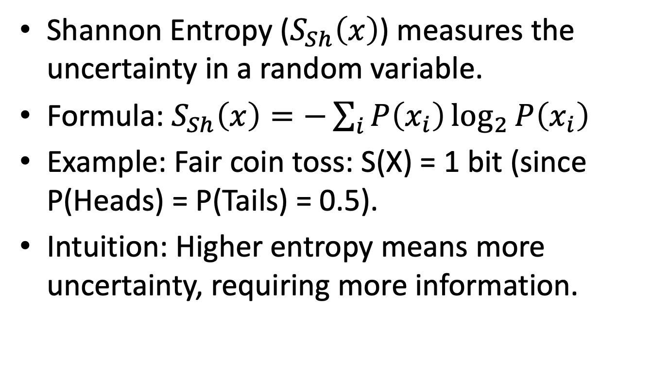
Shannon Entropy
Shannon Entropy ($S_{Sh}\left(x\right)$) measures the uncertainty in a random variable.
Formula: $S_{Sh}\left(x\right)=−\sum_{i}{P\left(x_{i}\right)\log_{2}{P\left(x_{i}\right)}}$
Example: Fair coin toss: S(X) = 1 bit (since P(Heads) = P(Tails) = 0.5).
Intuition: Higher entropy means more uncertainty, requiring more information.

Slide 8
Properties of Entropy
Maximum Entropy: When all outcomes are equally likely (uniform distribution).
Zero Entropy: When one outcome is certain (no uncertainty).
Higher Entropy: More uncertainty, more information required to predict.

Slide 9
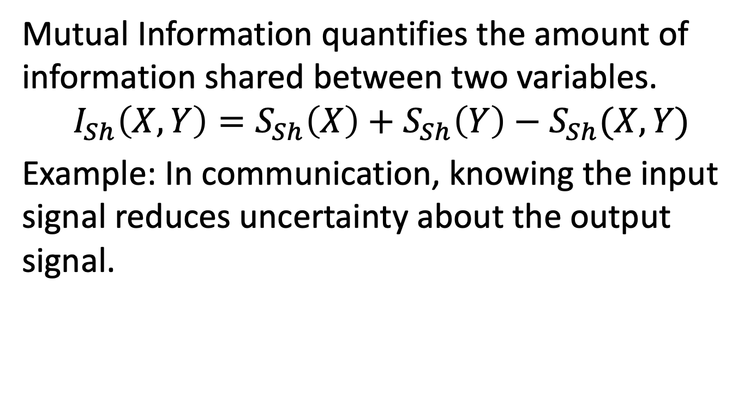
Mutual Information
Mutual Information quantifies the amount of information shared between two variables.
$$I_{Sh}\left(X,Y\right)=S_{Sh}\left(X\right)+S_{Sh}\left(Y\right)−S_{Sh}(X,Y)$$
Example: In communication, knowing the input signal reduces uncertainty about the output signal.

Slide 10
Applications in Real-World Scenarios
Data Compression: Shannon’s source coding theorem defines the minimum bits required.
Cryptography: Mutual information helps ensure secure communication.
Machine Learning: Information gain (based on entropy) helps build decision trees.

Slide 11
Introduction to Quantum Information Theory
Historical Background, Key Concepts, and Modern Developments

Slide 12
Historical Motivation
Early Quantum Mechanics: Developed in the early 20th century to explain phenomena like blackbody radiation and the photoelectric effect.
Key Experiments:
Double-Slit Experiment: Demonstrated wave-particle duality.
Stern-Gerlach Experiment: Showed intrinsic quantum properties (spin).
EPR Paradox: Introduced the concept of quantum entanglement.
Rise of Quantum Information Theory: Quantum computing and cryptography in the 1990s revolutionized information processing.

Slide 13


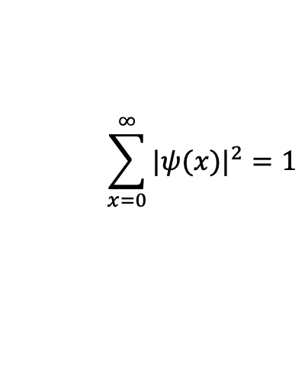



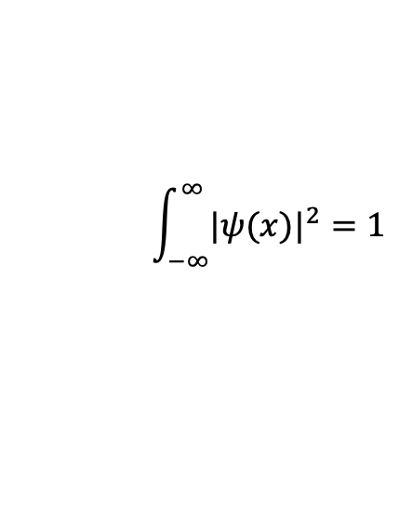

Wavefunction
For continuous variables
A complex-valued function $ψ:ℝ→ℂ$
$$ψ(x)=\left\langle x | ψ\right\rangle$$
$$\int_{−∞}^{∞}{{|ψ(x)|}^{2}}=1$$
$ℋ$
Space of wavefunction
Generally
$ψ:Χ→ℂ$
For discrete variables
A complex-valued function $ψ:ℕ→ℂ$
$$ψ(x)=\left\langle x | ψ\right\rangle$$
$$\sum_{x=0}^{∞}{{|ψ(x)|}^{2}}=1$$

Slide 14
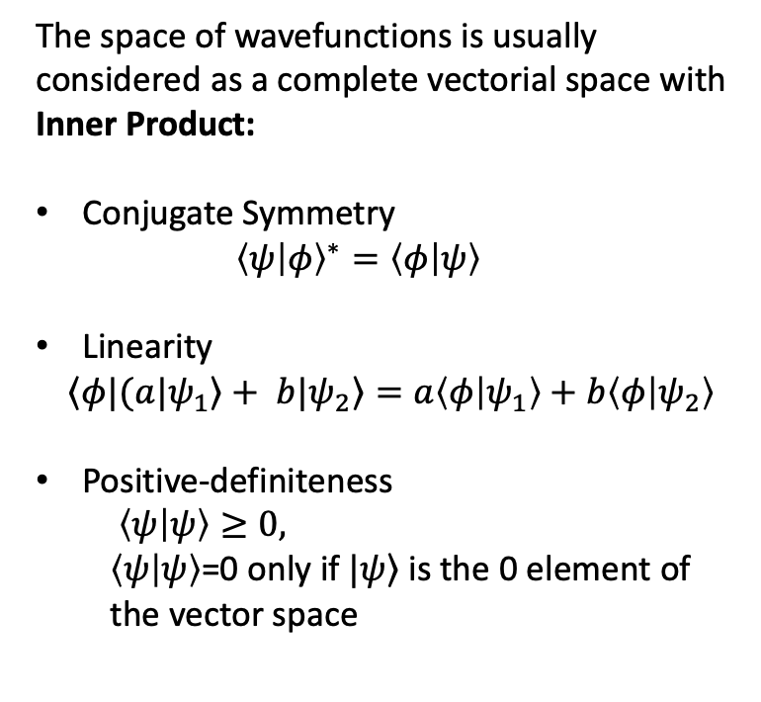

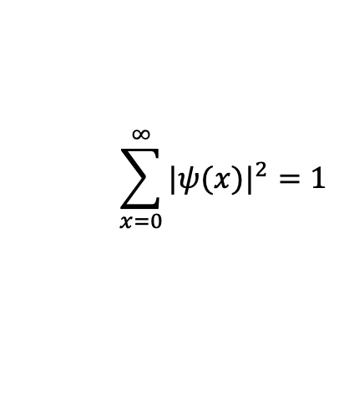

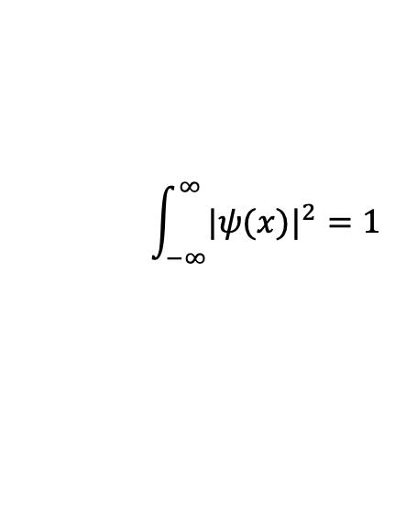
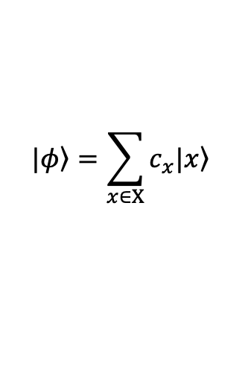

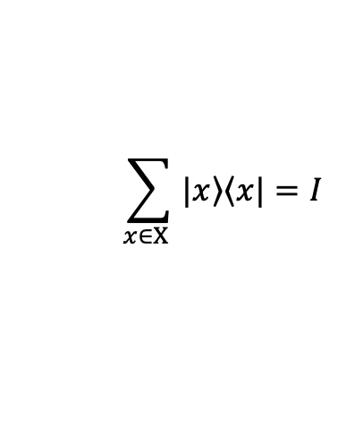
Wavefunction
Hilbert space structure
The space of wavefunctions is usually considered as a complete vectorial space with Inner Product:
Conjugate Symmetry
$${\left\langle ψ | φ\right\rangle }^{∗}=\left\langle φ | ψ\right\rangle$$
Linearity
$$\left.{\left\langle φ|\right.(a|ψ}_{1}\right\rangle +\left.{ b|ψ}_{2}\right\rangle =a\left\langle φ | ψ_{1}\right\rangle +b\left\langle φ | ψ_{2}\right\rangle$$
Positive-definiteness
$\left\langle ψ | ψ\right\rangle ≥0,$
$\left\langle ψ | ψ\right\rangle$=0 only if $|\left.ψ\right\rangle$ is the 0 element of the vector space
$$ψ(x)=\left\langle x | ψ\right\rangle$$
For continuous variables
A complex-valued function $ψ:ℝ→ℂ$
$$\int_{−∞}^{∞}{{|ψ(x)|}^{2}}=1$$
For discrete variables
A complex-valued function $ψ:ℕ→ℂ$
Completeness relation
$$\sum_{x∈Χ }{|\left.x\right\rangle \left\langle x|\right.}=I$$
$$|\left.φ\right\rangle =\sum_{x∈Χ}{c_{x}|\left.x\right\rangle }$$
$$\sum_{x=0}^{∞}{{|ψ(x)|}^{2}}=1$$

Slide 15

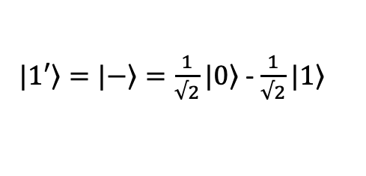



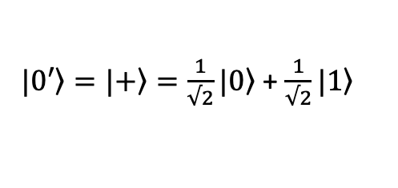

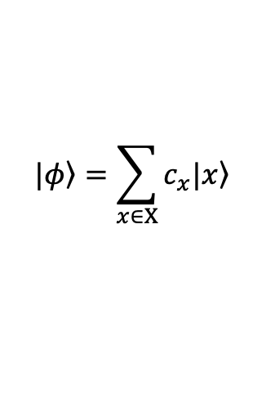

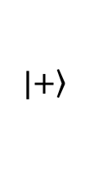
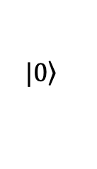

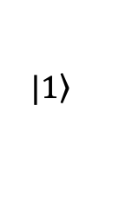

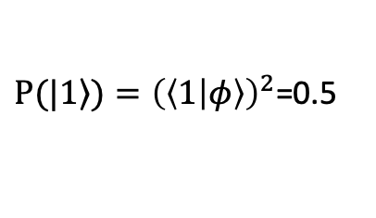
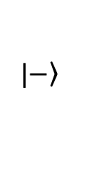
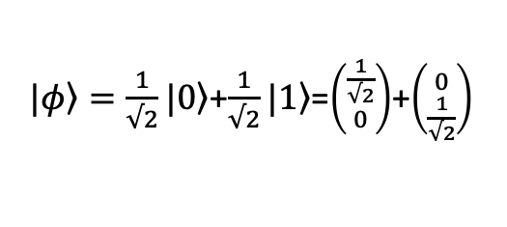
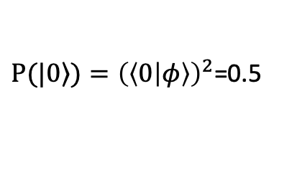

Wavefunction Examples
$$Χ=\{0,1\}$$
Alphabet of a qubit
$$|\left.1\right\rangle$$
Superposition:
A quantum state is a linear combination of basis vectors.
$$|\left.φ\right\rangle =\sum_{x∈Χ}{c_{x}|\left.x\right\rangle }$$
$$Χ=\{0,1\}$$
$|\left.φ\right\rangle =\frac{1}{√2}|\left.0\right\rangle$+$\frac{1}{√2}|\left.1\right\rangle$=$\left({\frac{1}{√2} \atop 0}\right)$+$\left({0 \atop \frac{1}{√2}}\right)$
$$\frac{1}{√2}$$
Measurement:
Probability distribution of random projection over computational basis.
$$\frac{1}{√2}$$
$$|\left.0\right\rangle$$
$P(|\left.0\right\rangle )={\left(\left\langle 0 | φ\right\rangle \right)}^{2}$=0.5
$P(|\left.1\right\rangle )={\left(\left\langle 1 | φ\right\rangle \right)}^{2}$=0.5
Change of basis:
One can change frame of reference
$$|\left.1\right\rangle$$
$$|\left.−\right\rangle$$
$$|\left.+\right\rangle$$
$|\left.0′\right\rangle =|\left.+\right\rangle =\frac{1}{√2}|\left.0\right\rangle$ + $\frac{1}{√2}|\left.1\right\rangle$
$|\left.φ\right\rangle =\frac{1}{√2}|\left.0\right\rangle$+$\frac{1}{√2}|\left.1\right\rangle$=$|\left.+\right\rangle$
$$\frac{1}{√2}$$
$|\left.1′\right\rangle =|\left.−\right\rangle =\frac{1}{√2}|\left.0\right\rangle$ - $\frac{1}{√2}|\left.1\right\rangle$
$$\frac{1}{√2}$$
$$|\left.0\right\rangle$$

Slide 16


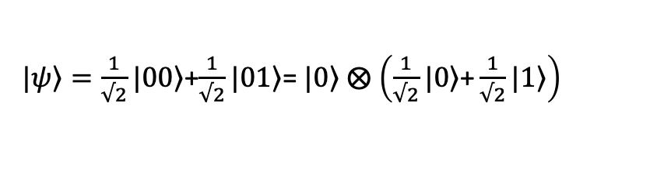




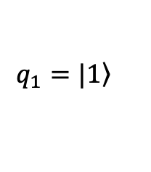

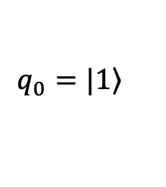

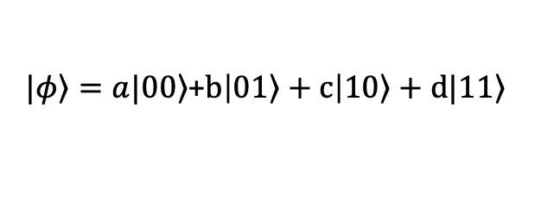


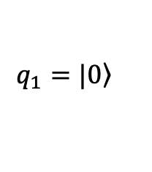

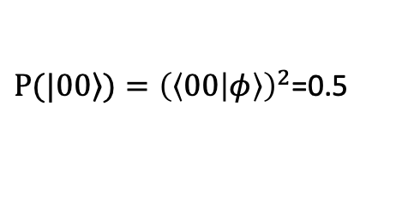

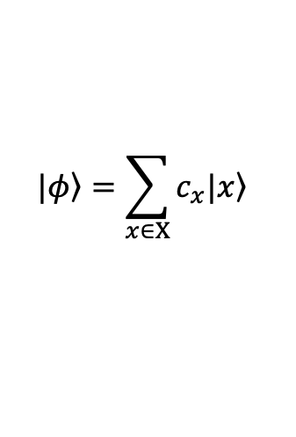

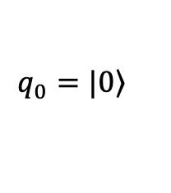

Wavefunction Examples
Tensor Product: $⨂$
Construction of Hilbert space from smaller composing spaces
$$ℋ_{Tot}=ℋ_{A}⨂ℋ_{B}$$
$$|\left.φ\right\rangle =\sum_{x∈Χ}{c_{x}|\left.x\right\rangle }$$
$$Χ=\{00,01,10,11\}$$
$|\left.φ\right\rangle =a|\left.00\right\rangle$+$b\left|0\left.1\right\rangle +c\right|\left.10\right\rangle +d|1\left.1\right\rangle$
$$ℋ_{Tot}=ℋ_{q_{0}}⨂ℋ_{q_{1}}$$
$$a^{2}+b^{2}+c^{2}+d^{2}=1$$
Entanglement:
An expression of strong quantum correlations.
$|\left.ψ\right\rangle =\frac{1}{√2}|\left.00\right\rangle$+$\frac{1}{√2}|\left.11\right\rangle$
$$q_{0}q_{1}$$
$$q_{0}q_{1}$$
$P(|\left.00\right\rangle )={\left(\left\langle 00 | φ\right\rangle \right)}^{2}$=0.5
$$q_{0}=|\left.0\right\rangle$$
$$q_{1}=|\left.0\right\rangle$$
$P(|\left.11\right\rangle )={\left(\left\langle 11 | φ\right\rangle \right)}^{2}$=0.5
$$q_{0}=|\left.1\right\rangle$$
$$q_{1}=|\left.1\right\rangle$$
Separable states:
Completely uncorrelated states
$|\left.ψ\right\rangle =\frac{1}{√2}|\left.00\right\rangle$+$\frac{1}{√2}|\left.01\right\rangle$= $|\left.0\right\rangle$ $⨂$ $\left(\frac{1}{√2}|\left.0\right\rangle \text{+}\frac{1}{√2}|\left.1\right\rangle \right)$
$$q_{0}q_{1}$$
$$q_{0}q_{1}$$
$$q_{0}$$
$$q_{1}$$
$$q_{1}$$

Slide 17


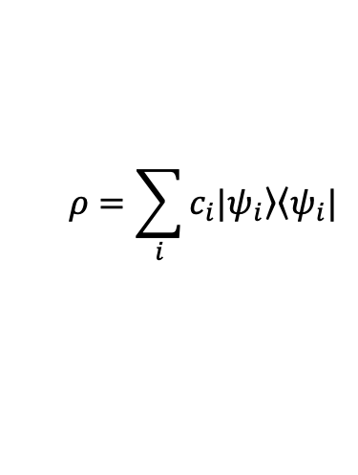
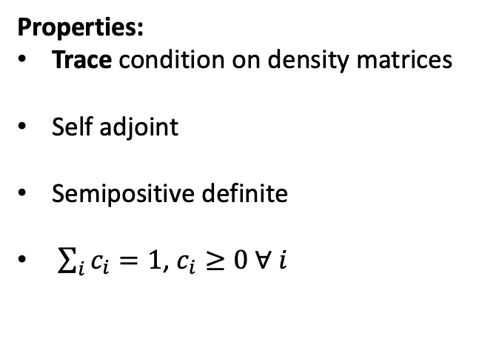
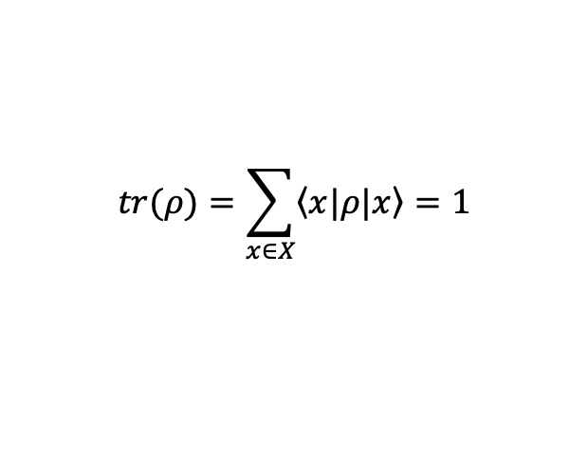
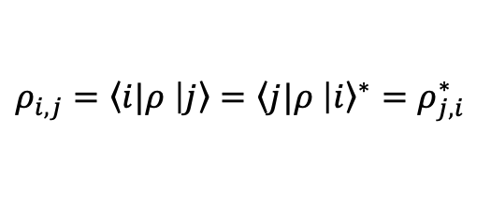
Density matrix A generalization of probability theory for quantum space
$$ρ=\sum_{i}{c_{i}|\left.ψ_{i}\right\rangle \left\langle ψ_{i}|\right.}$$
The basis of the $|\left.ψ_{i}\right\rangle$ might not be specified a priori
Properties:
Trace condition on density matrices
Self adjoint
Semipositive definite
$\sum_{i}{c_{i}}=1$, $c_{i}≥0 ∀ i$
$$tr(ρ)=\sum_{x∈X}{\left\langle x|\right.ρ|\left.x\right\rangle =1}$$
$ρ_{i,j}=\left\langle i|ρ\right.$ $\left|\left.j\right\rangle =\left\langle j|ρ\right. \right|{\left.i\right\rangle }^{∗}=ρ_{j,i}^{∗}$
$$ρ≥0$$

Slide 18
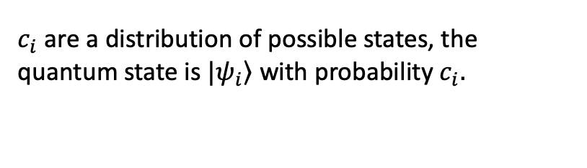
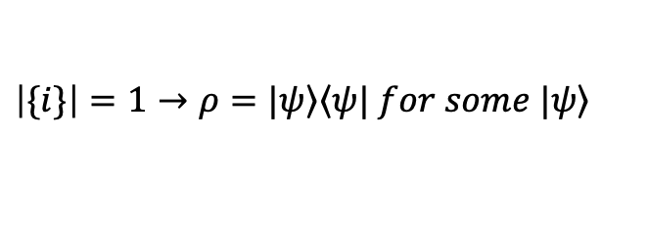

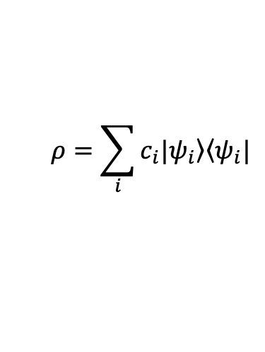
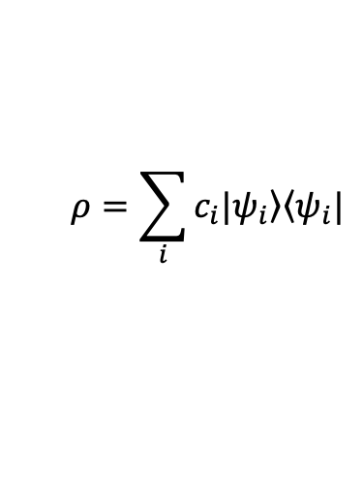


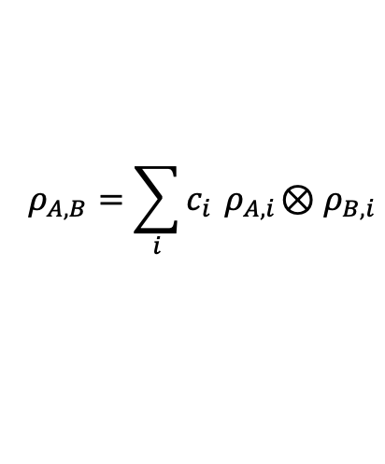

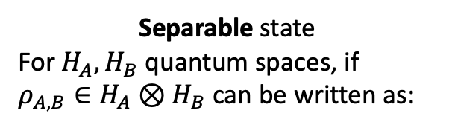
Density matrix A generalization of probability theory for quantum space
$$ρ=\sum_{i}{c_{i}|\left.ψ_{i}\right\rangle \left\langle ψ_{i}|\right.}$$
Pure state
$$\left|\{i\}\right|=1→ρ=|\left.ψ\right\rangle \left\langle ψ|\right. for some |\left.ψ\right\rangle$$
$$tr(ρ^{2})=1$$
Mixed state
$$ρ=\sum_{i}{c_{i}|\left.ψ_{i}\right\rangle \left\langle ψ_{i}|\right.}$$
$c_{i}$ are a distribution of possible states, the quantum state is $|\left.ψ_{i}\right\rangle$ with probability $c_{i}.$
$$tr(ρ^{2})≤1$$
$$\left|\{i\}\right|>1$$
Separable state
For $H_{A},H_{B}$ quantum spaces, if $ρ_{A,B}∈H_{A}⊗H_{B}$ can be written as:
Entangled state
Uncorrelated state
$$ρ_{A,B}=\sum_{i}{c_{i}{ ρ}_{A,i}⊗ρ_{B,i}}$$
Not Separable
$$ρ_{A,B}={ ρ}_{A}⊗ρ_{B}$$

Slide 19
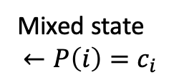
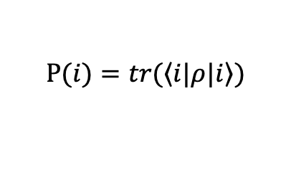

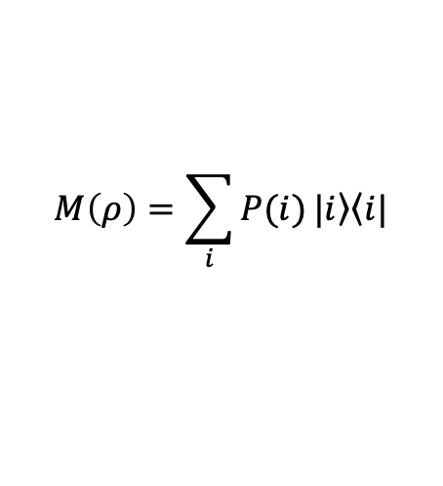
Quantum channels Evolution of a quantum state
A Trace Preserving Completely Positive Map (TPCPM) is an operation O defined on space $H_{A}$
such that:
$$∀ H_{E}, ρ_{E}∈H_{E}, ρ_{A}∈H_{A}, ρ^{′}=\left(I⊗O^{†}\right)\left(ρ_{E}⊗ρ_{A}\right)\left(I⊗O\right), →tr\left(ρ^{′}\right)=1, { ρ}^{′}≥0$$
Evolution of a quantum state by operator O
O is a physically meaningful operator O is a TPCPM
Measurement:
Random projection over computational basis.
Or measurement channel.
$$P(i)=tr(\left\langle i|ρ\right.|\left.i\right\rangle )$$
Mixed state
$$←P\left(i\right)=c_{i}$$
$$M\left(ρ\right)=\sum_{i}{P(i)}|\left.i\right\rangle \left\langle i|\right.$$
Unitary gate:
Evolution of state by unitary operator O, a.k.a. Quantum gate
$${ρ^{′}=O}^{†}ρO$$

Slide 20





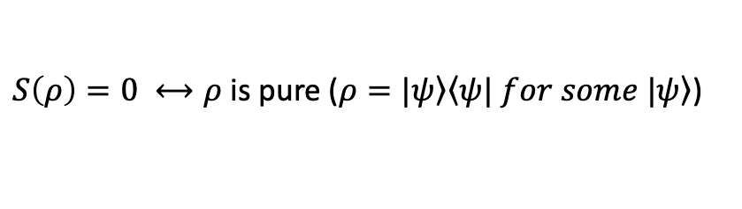

Von Neumann Entropy
Analogous to the entropy of statistical distributions, it values the entropy of a quantum state
$$S(ρ)=−tr(ρ\log_{2}{(ρ)})$$
…for the total space
What if one wants the entropy of part of the system?
Partial trace
Inverse operation than tensor product, analogous to marginalization in classical probability
$$ρ_{q_{0}}=tr{\left(ρ\right)}_{q_{1}}=\sum_{x∈X_{q_{1}}}{{\left\langle x|ρ\right.}_{q_{0},q_{1}}|\left.x\right\rangle }$$
H
$$H=H_{q_{0}}⊗⋯⊗H_{q_{N}}$$
$$q_{0}$$
$$S(ρ_{q_{0}})=−tr(ρ\log_{2}{(ρ_{q_{0}})})$$
$$q_{1}$$
$S\left(ρ\right)=0 ⟷ρ$ is pure ($ρ=|\left.ψ\right\rangle \left\langle ψ|\right. for some |\left.ψ\right\rangle$)
A single wavefunction as no uncertainty, everything is known, entropy is 0

Slide 21
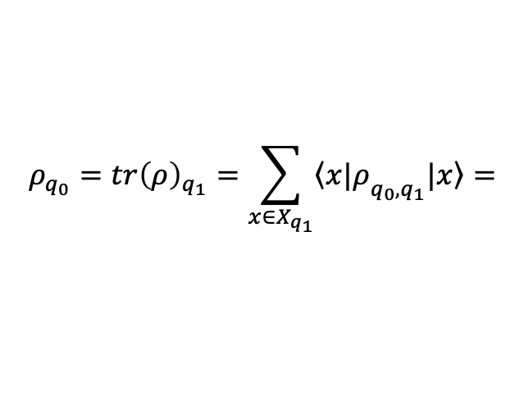
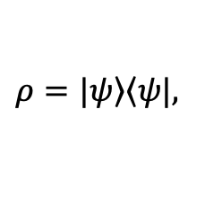

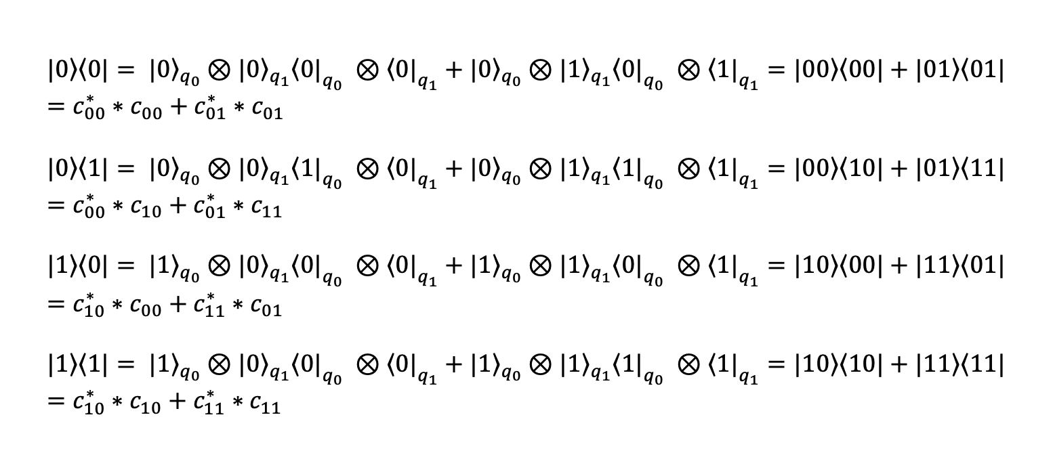

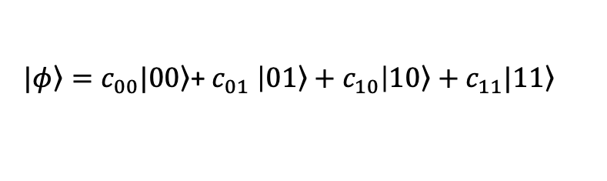


Partial trace
Example
$$Χ=\{00,01,10,11\}$$
$|\left.φ\right\rangle =c_{00}|\left.00\right\rangle$+ $c_{01} \left|0\left.1\right\rangle +c_{10}\right|\left.10\right\rangle +c_{11}|1\left.1\right\rangle$
$$ρ=|\left.ψ\right\rangle \left\langle ψ|\right.,$$
$$ℋ_{Tot}=ℋ_{q_{0}}⨂ℋ_{q_{1}}$$
$$c_{00}^{2}+c_{01}^{2}+c_{10}^{2}+c_{11}^{2}=1$$
$${\left(\begin{matrix}|\left.0\right\rangle \left\langle 0|\right. & |\left.0\right\rangle \left\langle 1|\right. \\ |\left.1\right\rangle \left\langle 0|\right. & |\left.1\right\rangle \left\langle 1|\right.\end{matrix}\right)}_{q_{0}}$$
$$ρ_{q_{0}}=tr{\left(ρ\right)}_{q_{1}}=\sum_{x∈X_{q_{1}}}{{\left\langle x|ρ\right.}_{q_{0},q_{1}}|\left.x\right\rangle }=$$
$$|\left.0\right\rangle \left\langle 0|\right.= |{\left.0\right\rangle }_{q_{0}}⊗|{\left.0\right\rangle }_{q_{1}}{\left\langle 0|\right.}_{q_{0}} ⊗{\left\langle 0|\right.}_{q_{1}}+|{\left.0\right\rangle }_{q_{0}}⊗|{\left.1\right\rangle }_{q_{1}}{\left\langle 0|\right.}_{q_{0}} ⊗{\left\langle 1|\right.}_{q_{1}}=|\left.00\right\rangle \left\langle 00|\right.+|\left.01\right\rangle \left\langle 01|\right.=c_{00}^{∗}∗c_{00}+c_{01}^{∗}∗c_{01}$$
$$|\left.0\right\rangle \left\langle 1|\right.= |{\left.0\right\rangle }_{q_{0}}⊗|{\left.0\right\rangle }_{q_{1}}{\left\langle 1|\right.}_{q_{0}} ⊗{\left\langle 0|\right.}_{q_{1}}+|{\left.0\right\rangle }_{q_{0}}⊗|{\left.1\right\rangle }_{q_{1}}{\left\langle 1|\right.}_{q_{0}} ⊗{\left\langle 1|\right.}_{q_{1}}=|\left.00\right\rangle \left\langle 10|\right.+|\left.01\right\rangle \left\langle 11|\right.=c_{00}^{∗}∗c_{10}+c_{01}^{∗}∗c_{11}$$
$$|\left.1\right\rangle \left\langle 0|\right.= |{\left.1\right\rangle }_{q_{0}}⊗|{\left.0\right\rangle }_{q_{1}}{\left\langle 0|\right.}_{q_{0}} ⊗{\left\langle 0|\right.}_{q_{1}}+|{\left.1\right\rangle }_{q_{0}}⊗|{\left.1\right\rangle }_{q_{1}}{\left\langle 0|\right.}_{q_{0}} ⊗{\left\langle 1|\right.}_{q_{1}}=|\left.10\right\rangle \left\langle 00|\right.+|\left.11\right\rangle \left\langle 01|\right.=c_{10}^{∗}∗c_{00}+c_{11}^{∗}∗c_{01}$$
$$|\left.1\right\rangle \left\langle 1|\right.= |{\left.1\right\rangle }_{q_{0}}⊗|{\left.0\right\rangle }_{q_{1}}{\left\langle 0|\right.}_{q_{0}} ⊗{\left\langle 0|\right.}_{q_{1}}+|{\left.1\right\rangle }_{q_{0}}⊗|{\left.1\right\rangle }_{q_{1}}{\left\langle 1|\right.}_{q_{0}} ⊗{\left\langle 1|\right.}_{q_{1}}=|\left.10\right\rangle \left\langle 10|\right.+|\left.11\right\rangle \left\langle 11|\right.=c_{10}^{∗}∗c_{10}+c_{11}^{∗}∗c_{11}$$

Slide 22










Von Neumann Mutual information
$$I\left(A,B\right)=S\left(A\right)+S\left(B\right)−S(A,B)$$
$$H=H_{q_{0}}⊗⋯⊗H_{q_{N}}$$
H
$$ρ_{q_{0},q_{1}}$$
$$I\left(q_{0},q_{1}\right)=S\left(q_{0}\right)+S\left(q_{1}\right)−S\left(q_{0},q_{1}\right)=−tr(ρ_{q_{0}}\log_{2}{(ρ_{q_{0}})})$$
$−tr(ρ_{q_{1}}\log_{2}{(ρ_{q_{1}})})$ $−tr(ρ_{q_{0},q_{1}}\log_{2}{(ρ_{q_{0},q_{1}})})$
$$q_{0}$$
$$q_{1}$$
$$H_{B}$$
$$ρ_{A,B}={ ρ}_{A}⊗ρ_{B}$$
$$S\left(A,B\right)=S\left(A\right)+S\left(B\right)$$
$$H_{A}$$
$$I\left(A,B\right)=S\left(A\right)+S\left(B\right)−S\left(A,B\right)=0$$

Slide 23














Classical and quantum information theory
Classical
Quantum
$$\sum_{i}{P(i)}=1$$
$$tr(ρ)=\sum_{x∈X}{\left\langle x|\right.ρ|\left.x\right\rangle =1}$$
Normalization condition
Positivity
Excluding space
Entropy
Mutual information
Indipendency
$$P\left(i\right)≥0 ∀ i$$
$$ρ≥0$$
$$P\left(a\right)=\sum_{b}{P(a,b)}$$
$$ρ_{q_{0}}=\sum_{x∈X_{q_{1}}}{{\left\langle x|ρ\right.}_{q_{0},q_{1}}|\left.x\right\rangle }$$
$$S_{Sh}\left(a\right)=\sum_{b}{−P\left(i\right)\log_{2}{P(i)}}$$
$$S_{vN}(ρ)=−tr(ρ\log_{2}{(ρ)})$$
$$I_{Sh}\left(A,B\right)=$$
$$I_{vN}\left(A,B\right)=$$
$$S_{Sh}\left(A\right)+S_{sh}\left(B\right)−S_{Sh}(A,B)$$
$$S_{vN}\left(A\right)+S_{vN}\left(B\right)−S_{vN}(A,B)$$
$$P\left(a,b\right)=P\left(a\right)P(b)$$
$$ρ_{A,B}={ ρ}_{A}⊗ρ_{B}$$

Slide 24













Mutual information Example
$$|\left.φ\right\rangle =\frac{1}{\sqrt{2}}\left.|00\right\rangle +\frac{1}{\sqrt{2}}|1\left.1\right\rangle =\left(\begin{matrix}\frac{1}{\sqrt{2}}, & 0, & 0, & \frac{1}{\sqrt{2}}\end{matrix}\right)$$
This is called maximally entangled state
$$q_{0}q_{1}$$
$$q_{0}q_{1}$$
$$ρ=| ψ⟩⟨ψ|=\left(\begin{matrix}\frac{1}{2} & 0 & 0 & \frac{1}{2} \\ 0 & 0 & 0 & 0 \\ 0 & 0 & 0 & 0 \\ \frac{1}{2} & 0 & 0 & \frac{1}{2}\end{matrix}\right)$$
Classical distribution
$$P\left(q_{0},q_{1}\right)=\frac{1}{2}δ_{{q_{0},q}_{1}}$$
$$ρ_{q_{0}}=tr{\left(ρ\right)}_{q_{1}}=\sum_{x∈X_{q_{1}}}{{\left\langle x|ρ\right.}_{q_{0},q_{1}}|\left.x\right\rangle }=\left(\begin{matrix}\frac{1}{2} & 0 \\ 0 & \frac{1}{2}\end{matrix}\right)$$
However
$$P\left(q_{0}\right)=\frac{1}{2} ∀q_{0}$$
,
$$P\left(q_{1}\right)=\frac{1}{2} ∀q_{1}$$
$$ρ_{q_{1}}=ρ_{q_{0}}$$
$I_{Sh}\left(A,B\right)=1+1−1$=1!!!
$${I_{vN}\left(q_{0},q_{1}\right)= S}_{vN}\left(q_{0}\right)+S_{vN}\left(q_{1}\right)−S_{vN}\left(q_{0},q_{1}\right)$$
$$= 1 + 1 + 0 =2$$
$$S_{vN}(ρ)=−tr(ρ\log_{2}{(ρ)})$$

Slide 25



Mutual information Coding exercise
I will give you a dictionary in python saved in a “wf.pkl” file
import pickle
with open('wf.dat', 'rb') as file:
wf_dict = pickle.load(file)
With these lines of code you can save the wavefunction within python, in this file you have a list of two elements
$$|\left.φ\right\rangle =\sum_{x∈Χ}{c_{x}|\left.x\right\rangle }$$
$$[[|\left.0\right\rangle ,|\left.1\right\rangle , ⋯,\left|\left.n−1\right\rangle \right],[c_{0},c_{1}⋯c_{n−1}]]$$
Each $|\left.x\right\rangle$ is used to represent a binary string of the qubits:
For example, each might be something of the form:
$|\left.x\right\rangle$='11100100100001110100000001’
Where each ‘1’/’0’represent the value of a qubit in that particular piece of the wavefunction. Here we have 26 qubits!

Slide 26


Mutual information Coding exercise
Objectives?
Calculate trace of the wavefunction, it should be equal to one.
Calculate partial trace to one qubit, e.g. the 0 qubit.
Calculate the partial trace to two qubit, e.g. the pair 0,1, qubits.
Calculate the entropy and mutual information of those two qubits.
Calculate the Mutual Information of all possible pairs of the 26 qubits!!!
Print the mutual information matrix.
Trace
Partial trace
$$tr(ρ)=\sum_{x∈X}{\left\langle x|\right.ρ|\left.x\right\rangle =1}$$
$$ρ_{q_{0}}=tr{\left(ρ\right)}_{q_{1}}=\sum_{x∈X_{q_{1}}}{{\left\langle x|ρ\right.}_{q_{0},q_{1}}|\left.x\right\rangle }$$

Slide 27
Partial trace
Example
$$Χ=\{00,01,10,11\}$$
$|\left.φ\right\rangle =c_{00}|\left.00\right\rangle$+ $c_{01} \left|0\left.1\right\rangle +c_{10}\right|\left.10\right\rangle +c_{11}|1\left.1\right\rangle$
$$ρ=|\left.ψ\right\rangle \left\langle ψ|\right.,$$
$$ℋ_{Tot}=ℋ_{q_{0}}⨂ℋ_{q_{1}}$$
$$c_{00}^{2}+c_{01}^{2}+c_{10}^{2}+c_{11}^{2}=1$$
$${\left(\begin{matrix}|\left.0\right\rangle \left\langle 0|\right. & |\left.0\right\rangle \left\langle 1|\right. \\ |\left.1\right\rangle \left\langle 0|\right. & |\left.1\right\rangle \left\langle 1|\right.\end{matrix}\right)}_{q_{0}}$$
$$ρ_{q_{0}}=tr{\left(ρ\right)}_{q_{1}}=\sum_{x∈X_{q_{1}}}{{\left\langle x|ρ\right.}_{q_{0},q_{1}}|\left.x\right\rangle }=$$
$$|\left.0\right\rangle \left\langle 0|\right.= |{\left.0\right\rangle }_{q_{0}}⊗|{\left.0\right\rangle }_{q_{1}}{\left\langle 0|\right.}_{q_{0}} ⊗{\left\langle 0|\right.}_{q_{1}}+|{\left.0\right\rangle }_{q_{0}}⊗|{\left.1\right\rangle }_{q_{1}}{\left\langle 0|\right.}_{q_{0}} ⊗{\left\langle 1|\right.}_{q_{1}}=|\left.00\right\rangle \left\langle 00|\right.+|\left.01\right\rangle \left\langle 01|\right.=c_{00}^{∗}∗c_{00}+c_{01}^{∗}∗c_{01}$$
$$|\left.0\right\rangle \left\langle 1|\right.= |{\left.0\right\rangle }_{q_{0}}⊗|{\left.0\right\rangle }_{q_{1}}{\left\langle 1|\right.}_{q_{0}} ⊗{\left\langle 0|\right.}_{q_{1}}+|{\left.0\right\rangle }_{q_{0}}⊗|{\left.1\right\rangle }_{q_{1}}{\left\langle 1|\right.}_{q_{0}} ⊗{\left\langle 1|\right.}_{q_{1}}=|\left.00\right\rangle \left\langle 10|\right.+|\left.01\right\rangle \left\langle 11|\right.=c_{00}^{∗}∗c_{10}+c_{01}^{∗}∗c_{11}$$
$$|\left.1\right\rangle \left\langle 0|\right.= |{\left.1\right\rangle }_{q_{0}}⊗|{\left.0\right\rangle }_{q_{1}}{\left\langle 0|\right.}_{q_{0}} ⊗{\left\langle 0|\right.}_{q_{1}}+|{\left.1\right\rangle }_{q_{0}}⊗|{\left.1\right\rangle }_{q_{1}}{\left\langle 0|\right.}_{q_{0}} ⊗{\left\langle 1|\right.}_{q_{1}}=|\left.10\right\rangle \left\langle 00|\right.+|\left.11\right\rangle \left\langle 01|\right.=c_{10}^{∗}∗c_{00}+c_{11}^{∗}∗c_{01}$$
$$|\left.1\right\rangle \left\langle 1|\right.= |{\left.1\right\rangle }_{q_{0}}⊗|{\left.0\right\rangle }_{q_{1}}{\left\langle 0|\right.}_{q_{0}} ⊗{\left\langle 0|\right.}_{q_{1}}+|{\left.1\right\rangle }_{q_{0}}⊗|{\left.1\right\rangle }_{q_{1}}{\left\langle 1|\right.}_{q_{0}} ⊗{\left\langle 1|\right.}_{q_{1}}=|\left.10\right\rangle \left\langle 10|\right.+|\left.11\right\rangle \left\langle 11|\right.=c_{10}^{∗}∗c_{10}+c_{11}^{∗}∗c_{11}$$

